Slide 1
Sketching with Hardware
07: Libraries & NeoPixel

Slide 2
Day 3: Wednesday, xx.yy.
09:00 Libraries & NeoPixel
11:00 Electronics 03
12:00 Lunch Break
13:00 Sensors & Actors
16:00 Demos
17:00 End

Slide 3
Arduino Libraries
Expand the functionality of the Arduino
Arduino is an open platform
Many compatible products from different manufacturers
Libraries for easier integration of those components

Slide 4
Examples for Libraries
Memory (EEPROM, SD)
Networking (Ethernet, GSM, WiFi)
Protocols (SPI, SoftwareSerial)
Output (LCD, TFT, Keyboard)
Signal processing (debouncing, FFT)

Slide 5
Installing Libraries
https://www.arduino.cc/en/Guide/Libraries
Library Manager:
Easy installation using the IDE
Sketch → Include Library → Manage Libraries…
Importing ZIP-Files:
Sketch → Include Library → Add .ZIP Library…
Sample programs are only shown after restarting the IDE
Necessary for some manufacturers
Manual installation:
Possible, but rarely necessary → we skip this one

Slide 6
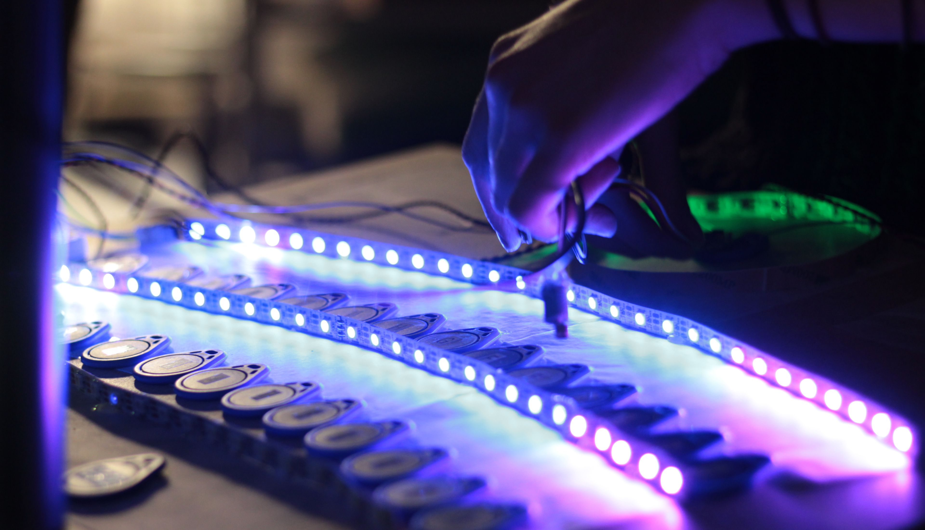
NeoPixel

Slide 7
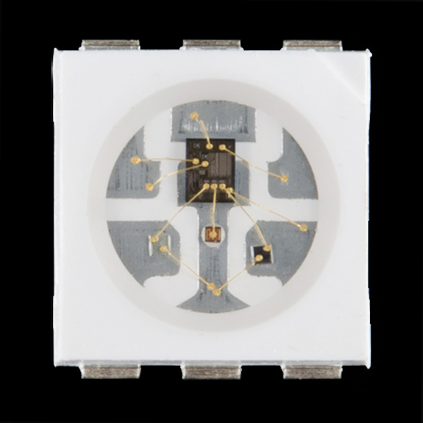
WS2812-LEDs
Chip with RBG-LEDs
Can be controlled with a serial protocol
Easy to use library for Arduino
https://cdn.sparkfun.com//assets/parts/8/0/3/7/11821-02.jpg

Slide 8
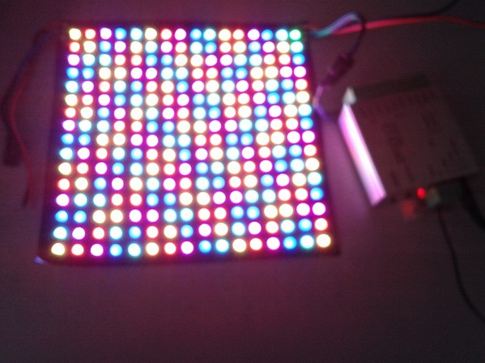
http://www.ledlite007.com/upfile/20131016104757492.jpg

Slide 9
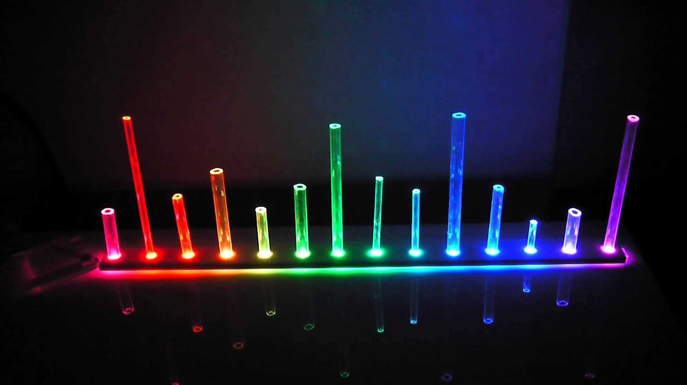
https://i.ytimg.com/vi/aTfXeM4NJJs/maxresdefault.jpg

Slide 10
Install the NeoPixel Library...
https://learn.adafruit.com/adafruit-neopixel-uberguide/arduino-library-installation
Sketch → Include Library → Manage Libraries…
Search for “NeoPixel”
Choose the latest version of “Adafruit NeoPixel”
Click the “Install” button

Slide 11
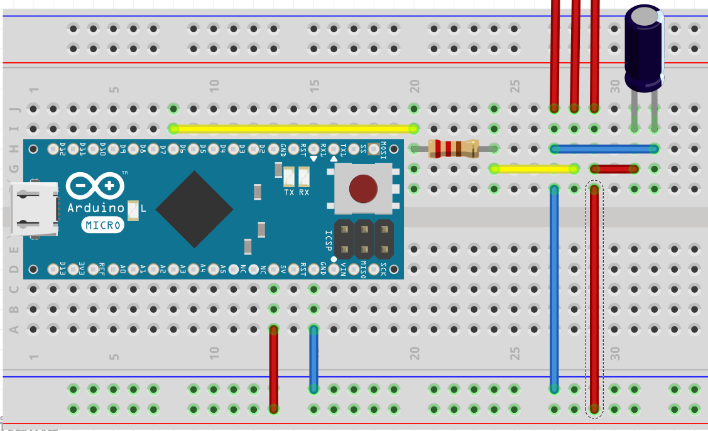
Connecting the LED strip
Resistor: 220Ω, Capacitor: 47μF
created with Fritzing

Slide 12
Exercise: NeoPixel

